Slide 1
Shiv Raj - Digital Forensics Specialist | Cybersecurity Portfolio
CAPSTONE PROJECT
Presented By:
1. Shiv Raj – MCA, Department of Computer Science, IET, khandari campus, Agra

Slide 2
OUTLINE
List the sections:
Problem Statement
System Development Approach (Technologies Used)
Algorithm & Deployment (Step by Step)
Result
Github and Deployment Link
Conclusion
Future Scope (optional)
References

Slide 3
Problem Statement
There is a need for a secure, visually advanced online portfolio for cybersecurity students/professionals to showcase their digital forensics skills, hands-on projects, and technical expertise for better career opportunities.
Existing portfolio options lack the cybersecurity focus and interactive features needed by technical fields.
The portfolio should be fast, secure, easy to update, and give a professional online presence.

Slide 4
System Approach
Technologies Used:
HTML5 for structure
CSS3 for dark/light themed design, advanced spacing, and readability
JavaScript for interactivity, dark mode, animations, secure contact form
Design Approach:
Modular separation for maintainability
Responsive/mobile-friendly layout
Security best practices (input validation, XSS protection, HTTPS-ready)
Accessible color palette and font hierarchy

Slide 5
Algorithm & Deployment
Site Architecture: Home, About, Skills, Projects, Contact, Innovation sections
Color palette optimized for cybersecurity theme (navy, teal, cyan)
Code organized: index.html (content/structure), style.css (theme/layout), app.js (animations/interactions)
Features:
Progressive loading sequence and animated text
Interactive skill cards with animated meters
Expandable project case studies/cards for hands-on projects
Contact form with input validation and XSS filtering
Responsive navigation and theme switching (dark/light)
Deployment: Uploaded to GitHub, published via Netlify (or other host), fully public and mobile-ready

Slide 6
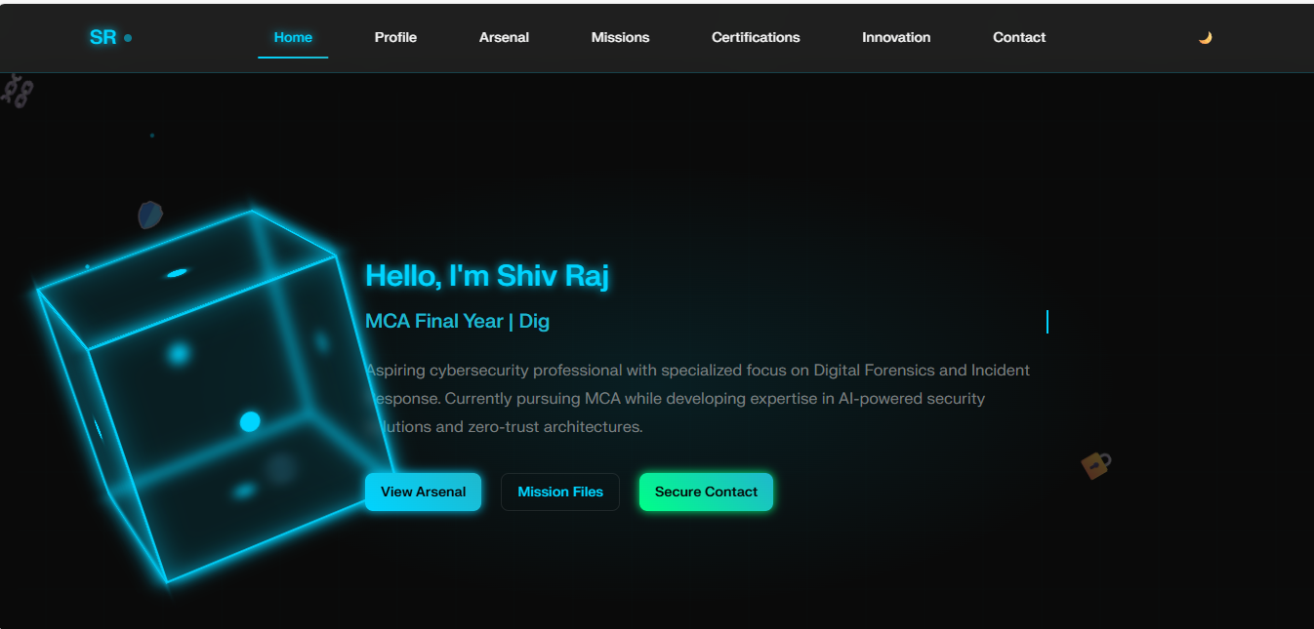
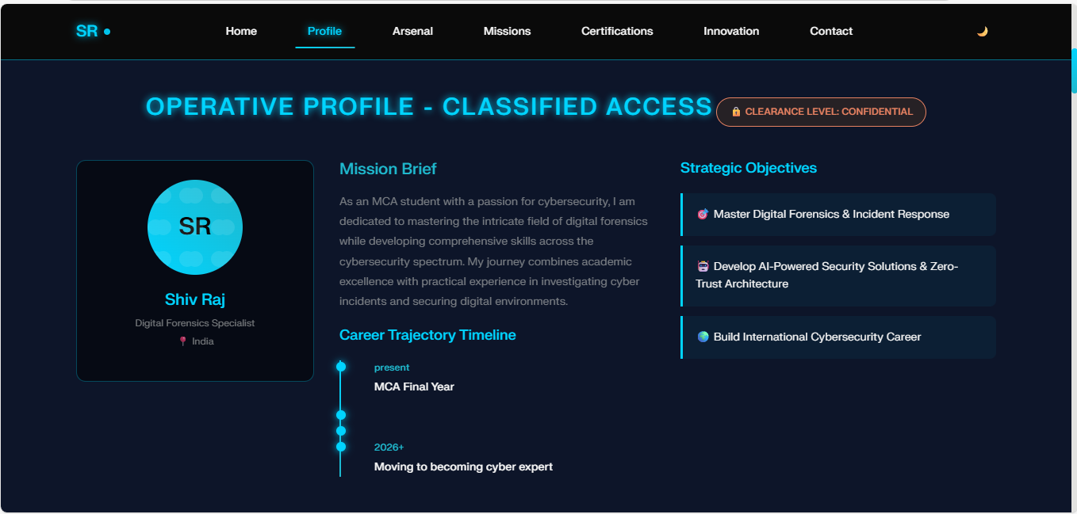
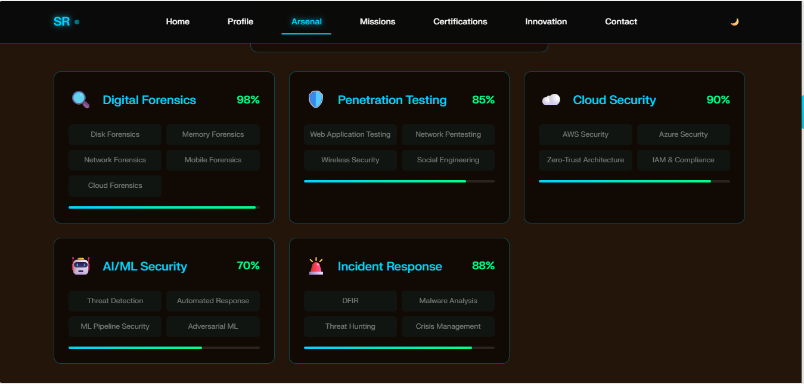
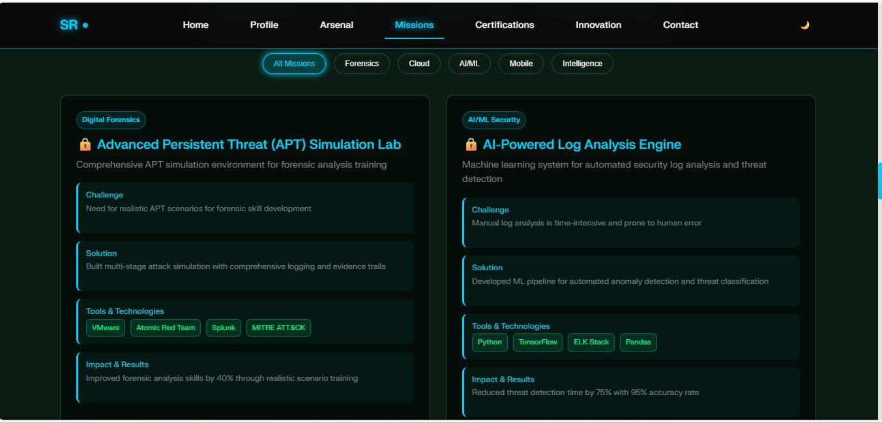
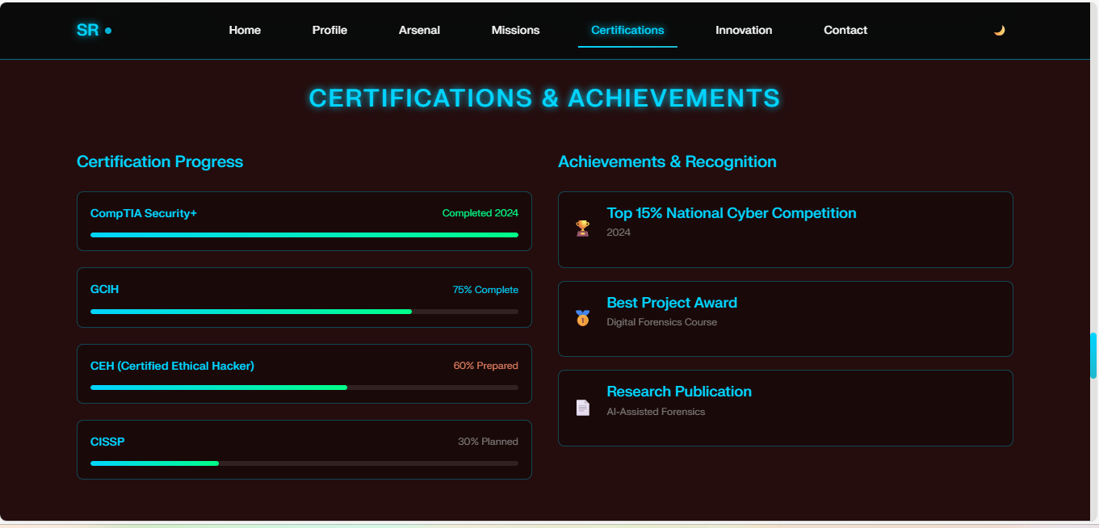
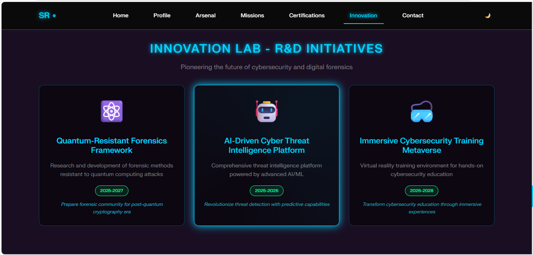
Result

Slide 7
GITHUB AND DEPLOYMNET LINK
Attach your Github Link : cybersecurity-portfolio/index.html at main · Jar258/cybersecurity-portfolio
Deployment link: Shiv Raj - Digital Forensics Specialist | Cybersecurity Expert

Slide 8
Conclusion
Portfolio demonstrates advanced digital forensics and cybersecurity skills geared to industry standards.
Provides strong online presence for networking and recruiter engagement.
Surpasses basic portfolio templates with niche features and optimized performance..

Slide 9
Future scope(Optional)
Add backend/dashboard for self-updates and analytics
Integrate user authentication for private demo projects
Expand case study section and blog capabilities
Add AI-powered job/project recommendations
Create a downloadable resume generator from live portfolio.

Slide 10
References
OWASP Secure Coding Practices
Google Fonts documentation
Github Pages/Netlify deployment docs
IBM Carbon & Material design guidelines
Official JavaScript/CSS documentation
[And some youtube videos]
NanthiniMoha/TNSDC-FWD-DIGITAL_PORTFOLIO

Slide 11
“Thank you for your attention.”

